Slide 1
IDS561 Big Data Analytics
Yuheng Hu
Assistant Professor@IDS

Slide 2
What we did last week
What is big data?
5 Vs of Big data?

Slide 3
Course Structure
Part I: Big Data Engineer
Data management, query processing
Part II: Big Data Scientist
Mining big data
Part III: Big Data Architect
Real-world big data pipeline

Slide 4
Today’s topic
Part I: Big Data Engineer
MapReduce/Hadoop
Query processing using Hadoop
NoSql vs Sql
CAP theorm, Databases on Mapreduce
Cloud computing and AWS

Slide 5
A toy example
Get top 3 most visited URLs for a given day?

Slide 6
A toy example
Get top 3 most visited URLs for a given day?

Slide 7
Get top 3 most visited URLs for a given day?

Slide 8
Get top 3 most visited URLs for a given day?
Get all URLs visited for each given day
Record the data in excel (Extract, Transform and Load, ETL), and Sort

Slide 9
Get top 3 most visited URLs for a given day for all Chicagoans?
3 million people in Chicago!

Slide 10
Get top 3 most visited URLs for a given day for all Chicagoans?
Excel may not work
Database for the win
Select top (3) URLs
From URLRecord
Order by URL_count desc

Slide 11
Get top 3 most visited URLs for a given day for people of Midwest ?
Over 65 million people!

Slide 12
Get top 3 most visited URLs for a given day for people of Midwest ?
Single database may not work
Distributed database or data warehouse

Slide 13
Fast forward…

Slide 14

What happens if processing 24 hours of data takes longer than 24 hours?
Jeff Hammerbacher, Information Platforms and the Rise of the Data Scientist. In, Beautiful Data, O’Reilly, 2009.
“On the first day of logging the Facebook clickstream, more than 400 gigabytes of data was collected. The load, index, and aggregation processes for this data set really taxed the Oracle data warehouse. Even after significant tuning, we were unable to aggregate a day of clickstream data in less than 24 hours.”

Slide 15
What’s changed? (In the era of Facebook, Google, etc)
Rise of social media and user-generated content
Large increase in data volume
Dropping cost of disks
Cheaper to store everything than to figure out what to throw away
I don’t know why should we keep that data; but let’s just keep it. Maybe we can use it someday!
Types of data collected From data that’s obviously valuable to data whose value is less apparent

Slide 16

“there are known knowns; there are things we know we know. We also know there are known unknowns; that is to say we know there are some things we do not know. But there are unknown unknowns – the ones we don't know we don't know…” – Donald Rumsfeld
Source: Wikipedia

Slide 17
Known and Unknown Unknowns
Query vs. Search
Databases are great if you know what questions to ask
“Known unknowns”
What if you don’t know what you’re looking for while you have a lot of data?
“Unknown unknowns”
Remember: Types of data collected from data that’s obviously valuable to data whose value is less apparent

Slide 18
What do we actually want in big data analytics?
Requirements
Scales out with more data
Cheaper than parallel databases
Able to run on cheap hardware
Ability to use any processing tool for any tasks

Slide 19
What do we actually want in big data analytics?
Requirements
Scales out with more data
Cheaper than parallel databases
Able to run on cheap hardware
Ability to use any processing tool

Slide 20
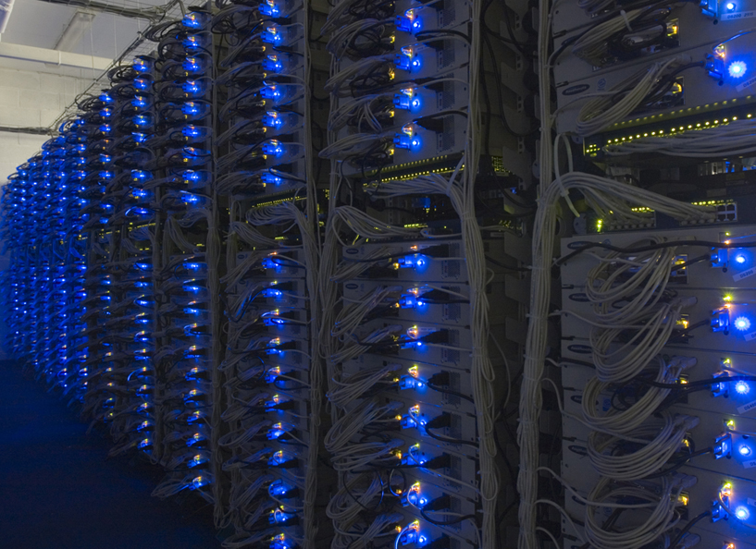
A Typical Cluster Architecture
2-10 Gbps backbone between racks
1 Gbps between
any pair of nodes
in a rack
Switch
Switch
Switch
CPU
CPU
CPU
CPU
Mem
…
Mem
Mem
…
Mem
Disk
Disk
Disk
Disk
Each rack contains 16-64 nodes
In 2011 it was estimated that Google had 1M machines, http://bit.ly/Shh0RO

Slide 21
What do we actually want in big data analytics?
Requirements
Scales out with more data
Cheaper than parallel databases
Able to run on cheap hardware
Ability to use any processing tool

Slide 22
High-level programming paradigm
High level Programming interface…

Slide 23
What are the challenges in big data analytics?
How to distribute computation?
Split data into small chunks and process them in parallel
But Machines can fail:
One server may stay up 3 years (1,000 days)
If you have 1,000 servers, expect to loose 1/day
People estimated Google had ~1M machines in 2011
1,000 machines fail every day!
How can we make it easy and robust to write distributed programs?

Slide 24
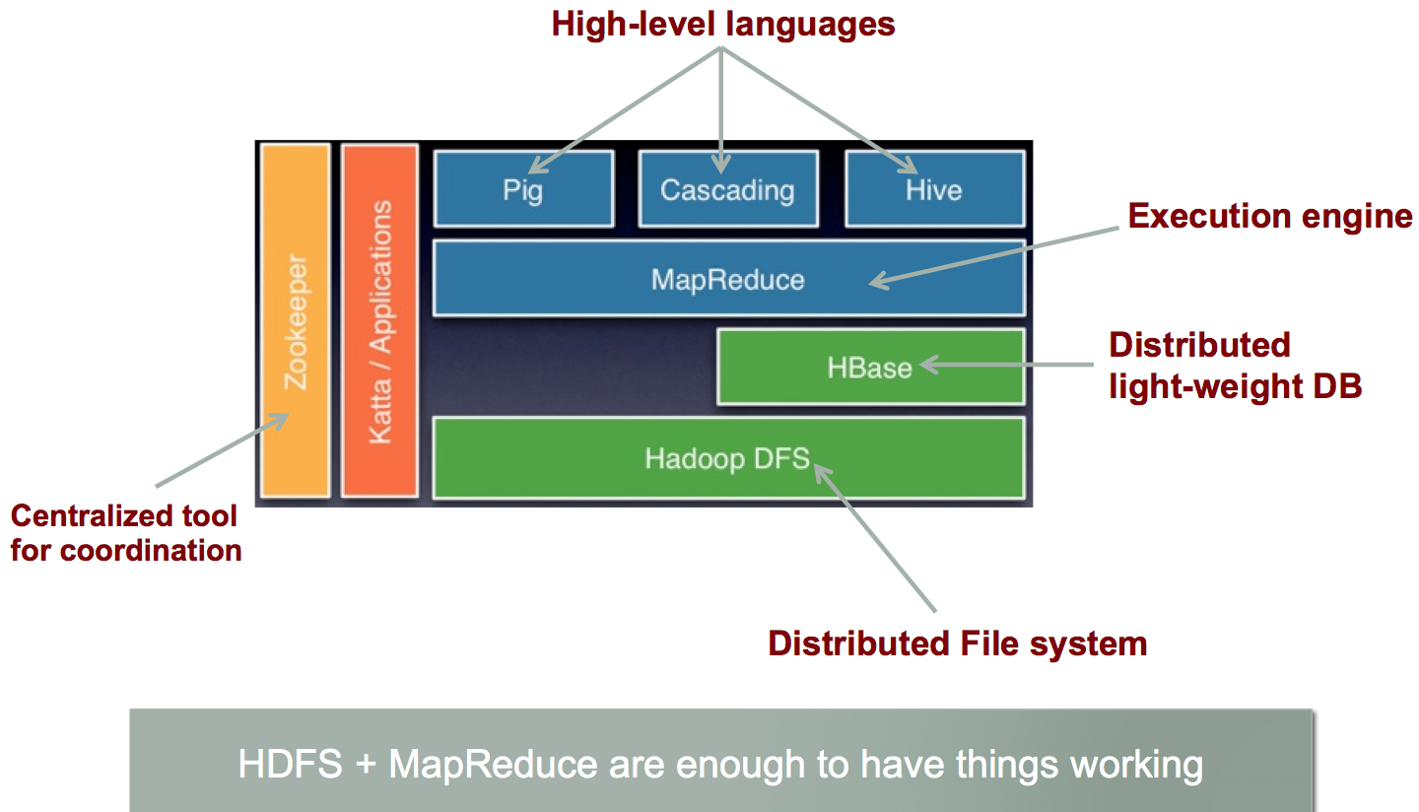
Idea and Solution
Idea
Store files multiple times for reliability
High-level programming paradigm
Solution
Hadoop

Slide 25
What is Hadoop?
An open-source implementation of frameworks for reliable, scalable, distributed computing and data storage.
It is a flexible and highly-available architecture for large scale computation and data processing on a network of commodity hardware.
Handles thousands of nodes and petabytes of data
Hadoop subprojects:
HDFS: Hadoop Distributed File System with high throughput access to application data
MapReduce: A software framework for distributed processing of large data sets on computer clusters
and some others (e.g, HIVE, HBASE)…

Slide 26
Schedule
Head first MapReduce
Next class
Head first HDFS+Hadoop cluster
1st Lab
Hadoop installation

Slide 27
Hadoop MapReduce
MapReduce is a programming model and software framework first developed by Google (Google’s MapReduce paper submitted in 2004)
Intended to facilitate and simplify the processing of vast amounts of data in parallel on large clusters in a reliable, fault-tolerant manner
Petabytes of data
Thousands of nodes
Computational processing occurs on both:
Unstructured data : filesystem
Structured data : database

Slide 28
A working example of MapReduce
We have a huge text document
Count the number of times each distinct word appears in the file
Sample application:
Analyze web server logs to find popular URLs

Slide 29
Possible Approaches
Hashtable solution
Maintain <word, count> pairs
Problem
What if file is too big?
What if there are a lot of files?

Slide 30
MapReduce solution
Provided by the programmer
Provided by the programmer
MAP:
Read input and produces a set of key-value pairs
Group by key:
Collect all pairs with same key
Reduce:
Collect all values belonging to the key and output
The crew of the space shuttle Endeavor recently returned to Earth as ambassadors, harbingers of a new era of space exploration. Scientists at NASA are saying that the recent assembly of the Dextre bot is the first step in a long-term space-based man/mache partnership. '"The work we're doing now -- the robotics we're doing -- is what we're going to need ……………………..
(The, 1)
(crew, 1)
(of, 1)
(the, 1)
(space, 1)
(shuttle, 1)
(Endeavor, 1)
(recently, 1)
….
(crew, 1)
(crew, 1)
(space, 1)
(the, 1)
(the, 1)
(the, 1)
(shuttle, 1)
(recently, 1)
…
(crew, 2)
(space, 1)
(the, 3)
(shuttle, 1)
(recently, 1)
…
Big document
(key, value)
(key, value)
(key, value)

Slide 31
Word Count Using MapReduce
map(key, value):
// key: document name; value: text of the document
for each word w in value:
emit(w, 1)
reduce(key, values):
// key: a word; value: an iterator over counts
result = 0
for each count v in values:
result += v
emit(key, result)

Slide 32
What is MapReduce?
MapReduce is a programming model for processing huge data sets with a parallel, distributed algorithm on a cluster
MapReduce is to divide a task into the sub-tasks in parallel, and aggregate the results of the sub-tasks to form the final output.
Programs written in MapReduce are automatically parallelized. Programmers write two functions: map and reduce.

Slide 33
Programming Model: MapReduce
Sequentially read a lot of data
Map:
Extract something you care about
Group by key: Sort and Shuffle
Reduce:
Aggregate, summarize, filter or transform
Write the result
Outline stays the same, Map and Reduce change to fit the problem

Slide 34
MapReduce: The Map Step
Input
key-value pairs
Intermediate
key-value pairs
k
v
map
k
v
k
v
map
k
v
k
v
…
…
k
v
k
v

Slide 35
Mapper
map(inKey, inValue) → list of (intermediateKey, intermediateValue)
The input to the map function is the form of key- value pairs, even though the input to a MapReduce program is a file or files.

Slide 36
Mapper
The output consists of a collection of key-value pairs which are input for the reduce function.
Think about Word count example.
The input to the mapper is each line of the file, while the output from each mapper is a set of key-value pairs where one word is the key and the number 1 is the value.
(a.txt, “I am taking IDS561 class. This class is fun.”) → (I, 1) (am, 1) (taking, 1) (IDS561, 1) (class, 1) (This, 1) (Class, 1) (is, 1) (fun, 1)

Slide 37
MapReduce: The Reduce Step
Output
key-value pairs
Intermediate
key-value pairs
Key-value groups
reduce
k
v
k
v
v
v
k
v
Group
by key
reduce
k
v
k
v
v
k
v
k
v
…
…
…
k
v
k
v
k
v

Slide 38
Reducer
reduce(intermediateKey, list(intermediateValue)) → list(outKey, outValue)
Each reduce function processes the intermediate values for a particular key generated by the map function and generates the output.
There exists a one-one mapping between keys and reducers. They are independent of one another. The number of reducers is decided by the user. By default, it is 1.

Slide 39
Reducer
^{Word count example}
(I, 1) (am, 1) (taking, 1) (IDS561, 1) (class, 1) (This, 1) (Class, 1) (is, 1) (fun, 1)→(I, 1) (am, 1) (taking, 1) (IDS561, 1) (class, 2) (This, 1) (is, 1) (fun, 1)

Slide 40
Another example of MapReduce

Slide 41
One more example
Finding the frequent intersection (>=3) of edges among multiple graphs
What Mapper and Reducer look like?

Slide 42
Mapper1:
1→2: G1
1->3: G1
Mapper2
1→2: G2
…
Mapper3
1→7: G3
Reducer
1->2: Yes
Because 1→2: G1,G2,G3…
1→3:NO
Because 1→3: G1,G3…

Slide 43
Word Count Using MapReduce
map(key, value):
// key: document name; value: text of the document
for each word w in value:
emit(w, 1)
reduce(key, values):
// key: a word; value: an iterator over counts
result = 0
for each count v in values:
result += v
emit(key, result)

Slide 44
Map-Reduce summary
Programmer specifies:
Map and Reduce and input files
Workflow:
Read inputs as a set of key-value-pairs
Map transforms input kv-pairs into a new set of k'v'-pairs
Sorts & Shuffles the k'v'-pairs to output nodes
All k’v’-pairs with a given k’ are sent to the same reduce
Reduce processes all k'v'-pairs grouped by key into new k''v''-pairs
Write the resulting pairs to files
All phases are distributed with many tasks doing the work
Input 0
Input 1
Input 2
Map 0
Map 1
Map 2
Shuffle
Reduce 0
Reduce 1
Out 0
Out 1

Slide 45
Refinements: Backup Tasks
Problem
Slow workers significantly lengthen the job completion time:
Other jobs on the machine
Bad disks
Weird things
Solution
Near end of phase, spawn backup copies of tasks
Whichever one finishes first “wins”
Effect
Dramatically shortens job completion time

Slide 46
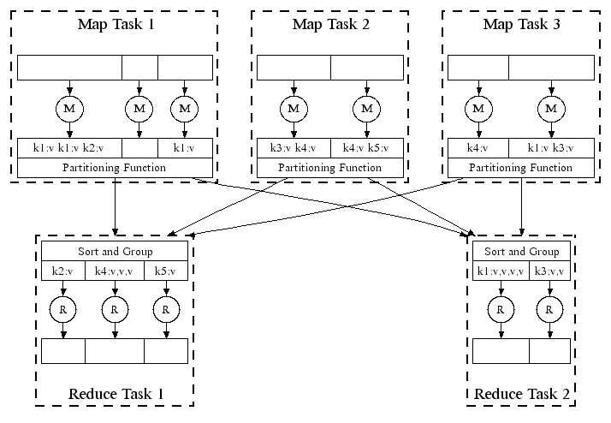
Refinement: Combiners
Often a Map task will produce many pairs of the form (k,v₁), (k,v₂), … for the same key k
E.g., popular words in the word count example
Can save network time by pre-aggregating values in the mapper:
combine(k, list(v₁)) → v₂
Combiner is usually same as the reduce function
Works only if reduce function is commutative and associative

Slide 47
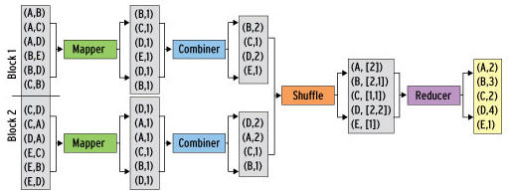
Refinement: Combiners
Back to our word counting example:
Combiner combines the values of all keys of a single mapper (single machine):
Much less data needs to be copied and shuffled!

Slide 48
Refinement: Partition Function
Remember we have multiple reducers
Want to control how keys get partitioned
Inputs to map tasks are created by contiguous splits of input file
Reduce needs to ensure that records with the same intermediate key end up at the same worker
System uses a default partition function:
hash(key) mod R
Sometimes useful to override the hash function:
E.g., hash(hostname(URL)) mod R ensures URLs from a host end up in the same output file

Slide 49
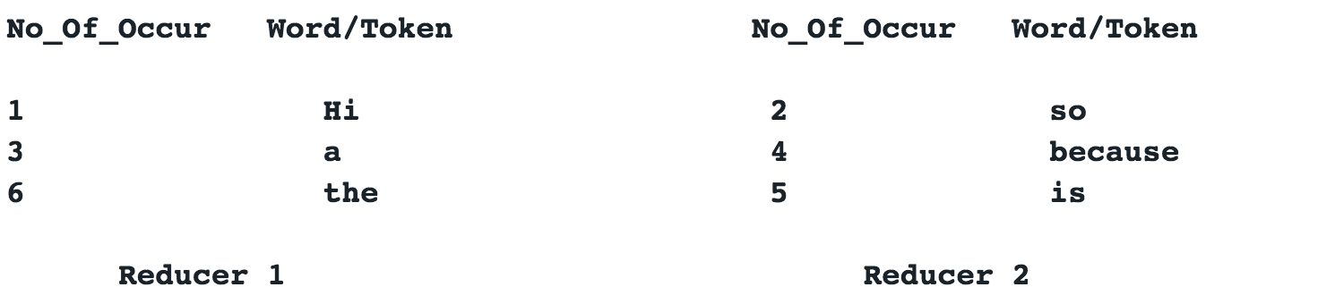
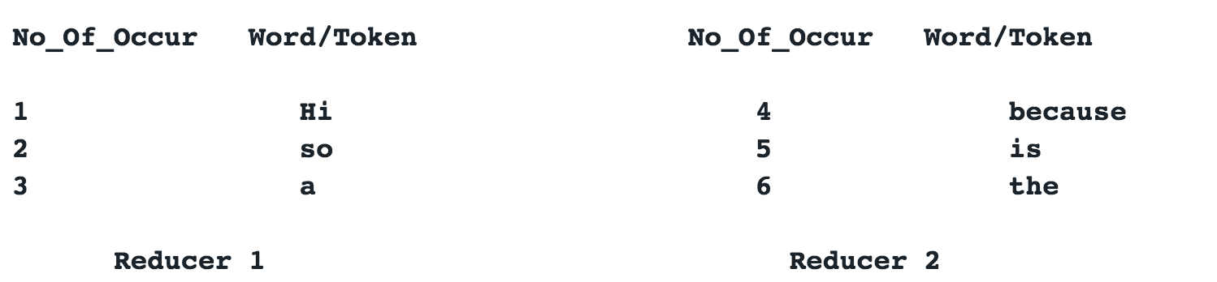
Why Partition is important?
partitioning has a direct impact on the overall performance of job we want to run.
sometimes required to control the key/value pairs (emitted from mapper) partitioning over the reducers.
all the tokens having a number of occurrences less than N (here 4) are sent to reducer 1 and the others are sent to reducer 2, resulting in two ordered partitions

Slide 50
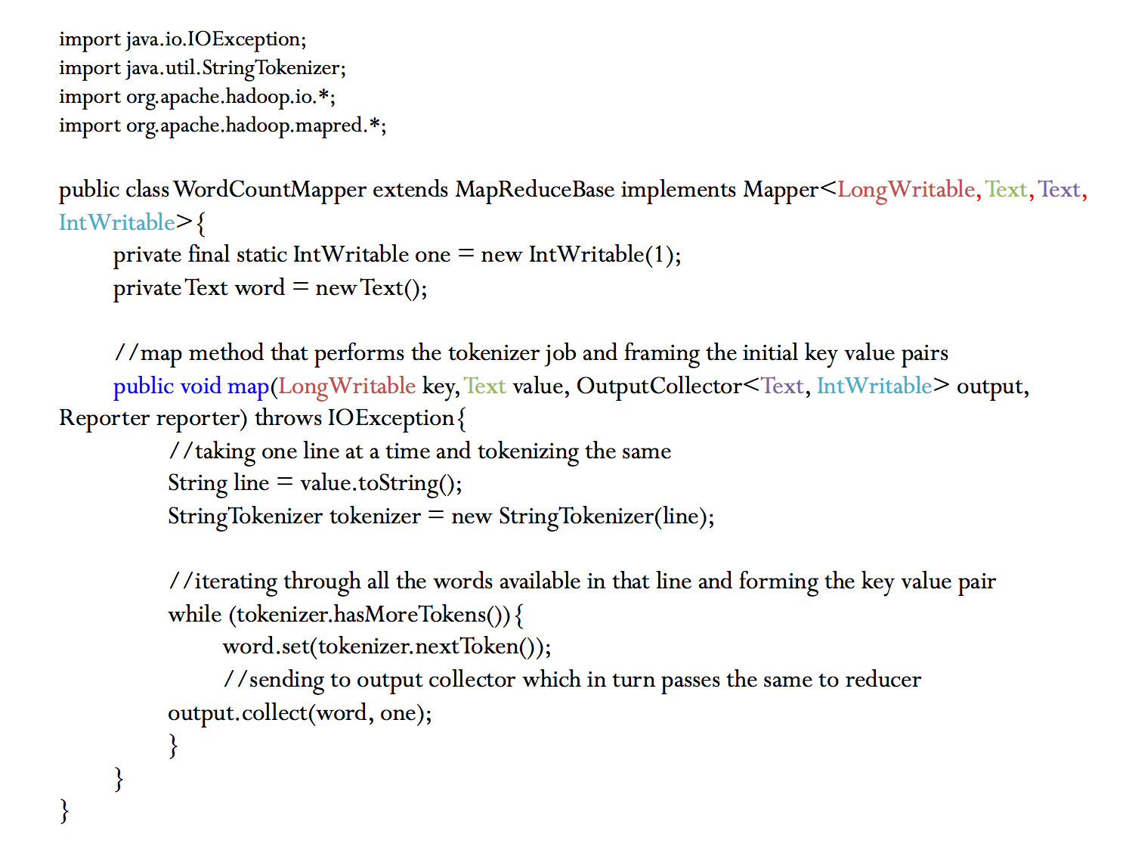
^{Mapper Class}

Slide 51
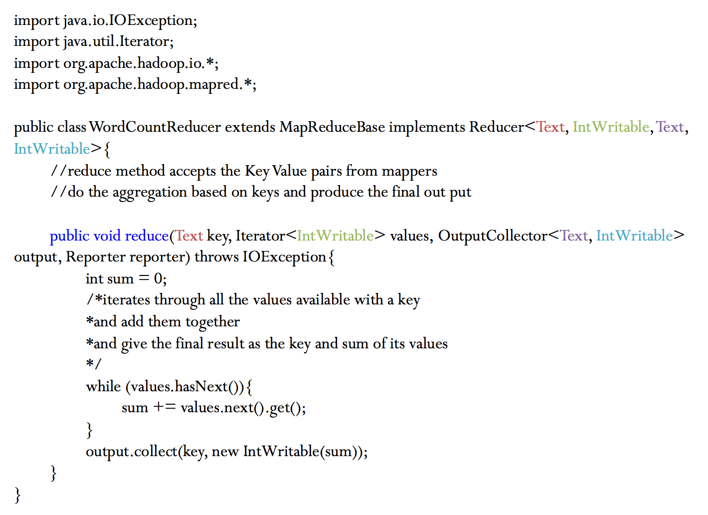
^{Reducer Class}

Slide 52
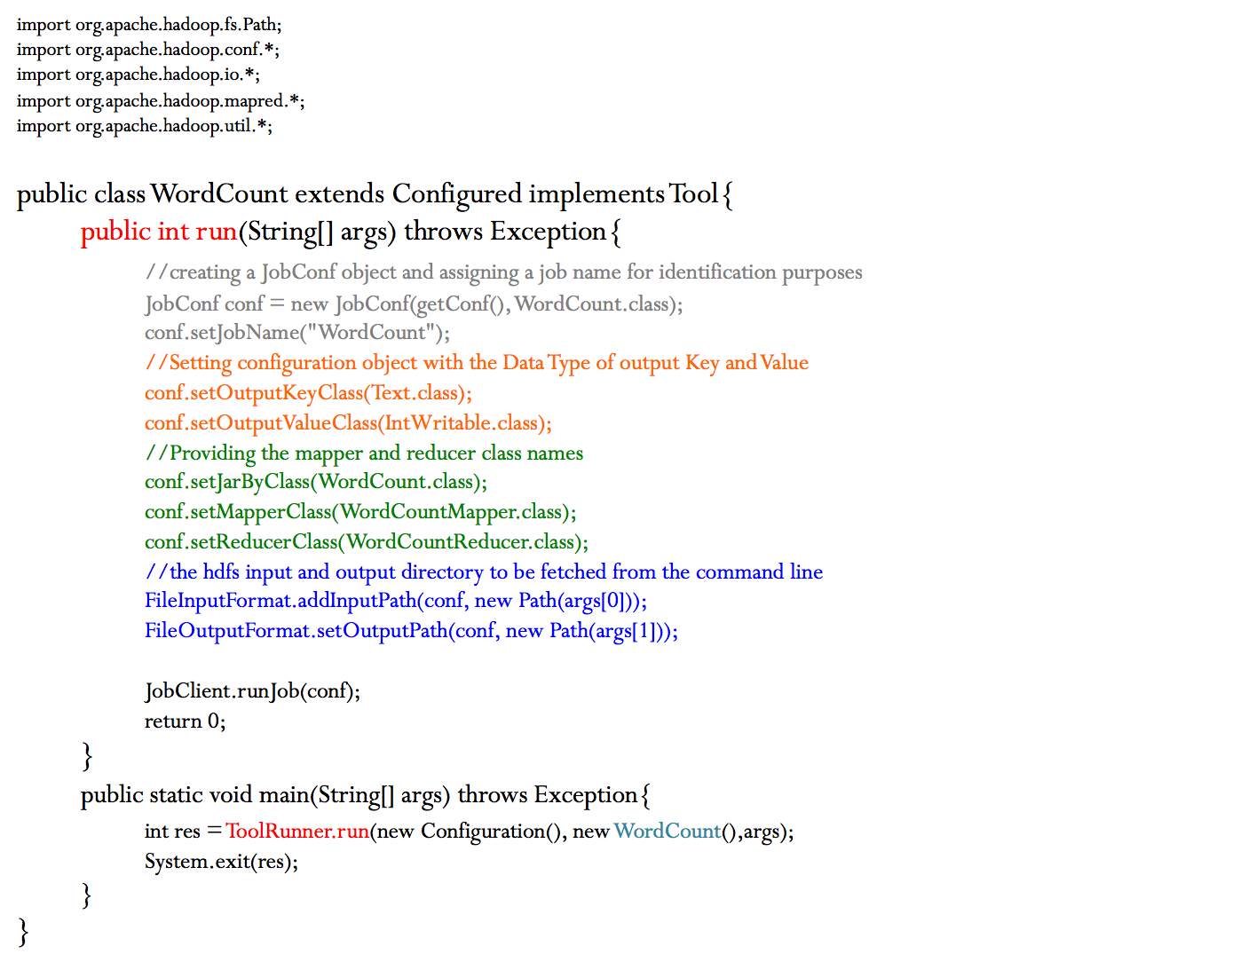
^{Driver Class}

Slide 53
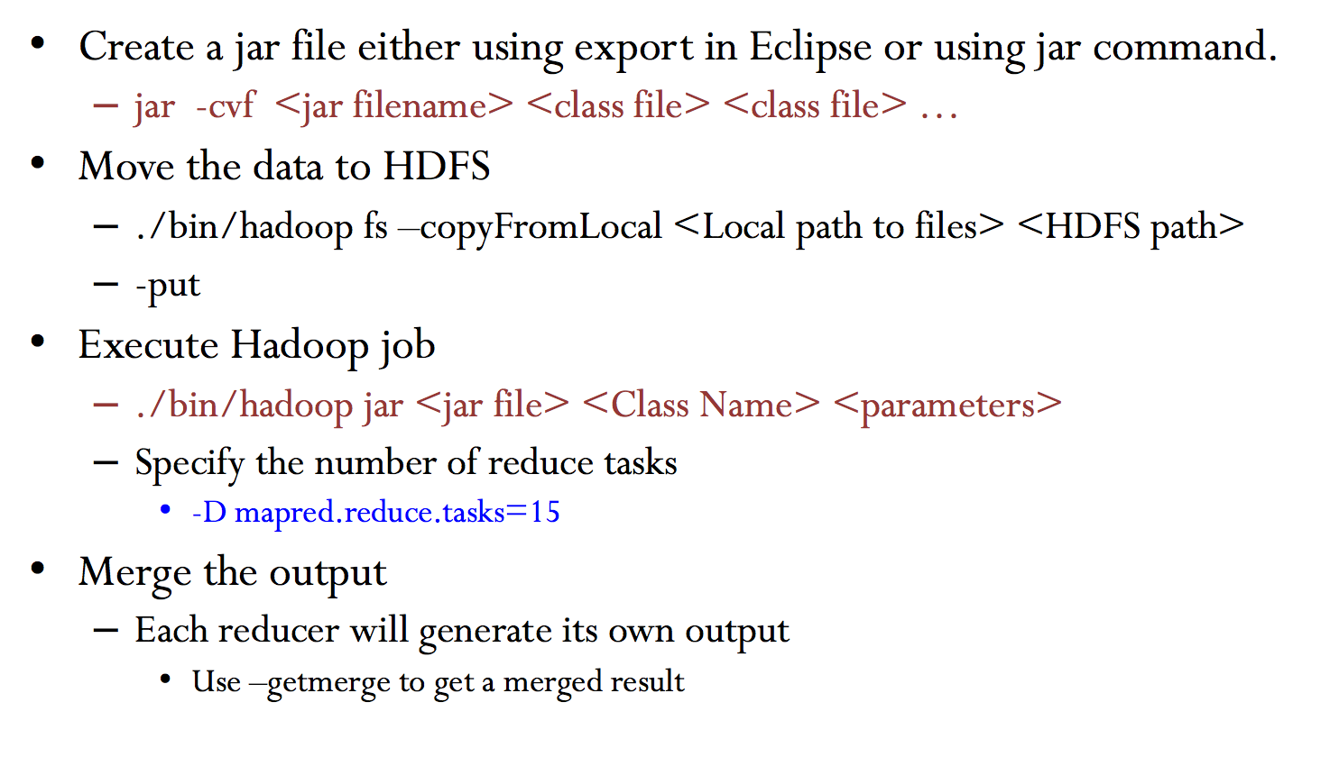
Run MapReduce Programs under Hadoop

Slide 54
Schedule
Head first MapReduce
Next week:
Head first HDFS+Hadoop cluster
First Lab session

Slide 55
HDFS in details
HDFS: Hadoop Distributed File System with high throughput access to application data

Slide 56
What do we actually want in big data analytics?
Requirements
Scales out with more data
Massively parallel
Cheaper than parallel databases
Able to run on cheap hardware!
Ability to use any processing tool

Slide 57
From Jeff Dean’s slides

Slide 58
HDFS
The Hadoop Distributed File System (HDFS) is a distributed file system designed to run on commodity hardware. It has many similarities with existing distributed file systems. However, the differences from other distributed file systems are significant.
highly fault-tolerant and is designed to be deployed on low-cost hardware.
provides high throughput access to application data and is suitable for applications that have large data sets.

Slide 59

Hadoop’s Architecture (HDFS)
NameNode:
Stores metadata for the files, like the directory structure of a typical FS.
The server holding the NameNode instance is quite crucial, as there is only one.
Transaction log for file deletes/adds, etc. Does not use transactions for whole blocks or file-streams, only metadata.
Handles creation of more replica blocks when necessary after a DataNode failure

Slide 60
Hadoop’s Architecture (HDFS)
DataNode :
Stores the actual data in HDFS
Can run on any underlying filesystem (ext3/4, NTFS, etc)
Notifies NameNode of what blocks it has
NameNode replicates blocks 2-3x in local rack, 1x elsewhere

Slide 61
Keep in mind…
One of each:
Namenode (NN): master node for HDFS
Jobtracker (JT): master node for job submission
Set of each per slave machine:
Tasktracker (TT): contains multiple task slots
Datanode (DN): serves HDFS data blocks
* Not quite… leaving aside YARN for now

Slide 62
Keep things reliable
Reliable distributed file system
Data kept in “slave” spread across machines
Each slave/chunk replicated on different machines
Seamless recovery from disk or machine failure
C₀
C₁
D₀
C₁
C₂
C₅
C₀
C₅
…
C₅
C₂
C₅
C₃
D₀
D₁
D₀
C₂

Slide 63
Putting everything together…
namenode
job submission node
namenode daemon
jobtracker
tasktracker
tasktracker
tasktracker
datanode daemon
datanode daemon
datanode daemon
Linux file system
Linux file system
Linux file system
…
…
…
slave node
slave node
slave node

Slide 64
Anatomy of a Job
MapReduce program in Hadoop = Hadoop job
Jobs are divided into map and reduce tasks
An instance of running a task is called a task attempt (occupies a slot)
Multiple jobs can be composed into a workflow
Job submission:
Client (i.e., driver program) creates a job, configures it, and submits it to jobtracker
That’s it! The Hadoop cluster takes over…

Slide 65
Anatomy of a Job
Behind the scenes:
Input splits are computed (on client end)
Job data (jar, configuration XML) are sent to JobTracker
JobTracker puts job data in shared location, enqueues tasks
TaskTrackers poll for tasks
Off to the races…

Slide 66
Input File
Input File
InputSplit
InputSplit
InputSplit
InputSplit
InputSplit
InputFormat
RecordReader
RecordReader
RecordReader
RecordReader
RecordReader
Mapper
Mapper
Mapper
Mapper
Mapper
Intermediates
Intermediates
Intermediates
Intermediates
Intermediates
Source: redrawn from a slide by Cloduera, cc-licensed

Slide 67
Client
Records
…
…
InputSplit
InputSplit
InputSplit
RecordReader
RecordReader
RecordReader
Mapper
Mapper
Mapper

Slide 68
Mapper
Mapper
Mapper
Mapper
Mapper
Intermediates
Intermediates
Intermediates
Intermediates
Intermediates
Partitioner
Partitioner
Partitioner
Partitioner
Partitioner
(combiners omitted here)
Intermediates
Intermediates
Intermediates
Reducer
Reducer
Reduce
Source: redrawn from a slide by Cloduera, cc-licensed

Slide 69
Reducer
Reducer
Reduce
OutputFormat
RecordWriter
RecordWriter
RecordWriter
Output File
Output File
Output File
Source: redrawn from a slide by Cloduera, cc-licensed

Slide 70
Input and Output
InputFormat:
TextInputFormat
KeyValueTextInputFormat
SequenceFileInputFormat
…
OutputFormat:
TextOutputFormat
SequenceFileOutputFormat
…

Slide 71
Shuffle and Sort in Hadoop
Probably the most complex aspect of MapReduce
Map side
Map outputs are buffered in memory in a circular buffer
When buffer reaches threshold, contents are “spilled” to disk
Spills merged in a single, partitioned file (sorted within each partition): combiner runs during the merges
Reduce side
First, map outputs are copied over to reducer machine
“Sort” is a multi-pass merge of map outputs (happens in memory and on disk): combiner runs during the merges
Final merge pass goes directly into reducer

Slide 72
Shuffle and Sort
Mapper
intermediate files (on disk)
merged spills (on disk)
Combiner
Reducer
circular buffer (in memory)
Combiner
other reducers
spills (on disk)
other mappers

Slide 73

Hadoop Workflow
1. Load data into HDFS
2. Develop code locally
3. Submit MapReduce job
3a. Go back to Step 2
Hadoop Cluster
You
4. Retrieve data from HDFS

Slide 74
Recommended Workflow
Here’s how I work:
Develop code in Eclipse on host machine
Build distribution on host machine
Check out copy of code on VM
Copy (i.e., scp) jars over to VM (in same directory structure)
Run job on VM
Iterate
…
Commit code on host machine and push
Pull from inside VM, verify
Avoid using the UI of the VM
Directly ssh into the VM

Slide 75
MapReduce-Fault tolerance
Slave(worker) failure: The master pings every worker periodically. If no response is received from a worker in a certain amount of time, the master marks the worker as failed. Any map tasks completed by the worker are reset back to their initial idle state, and therefore become eligible for scheduling on other workers. Similarly, any map task or reduce task in progress on a failed worker is also reset to idle and becomes eligible for rescheduling.
Master Failure: It is easy to make the master write periodic checkpoints of the master data structures described above. If the master task dies, a new copy can be started from the last checkpointed state. However, in most cases, the user restarts the job.

Slide 76
Schedule next week
Part I: Big data engineer
Query processing on hadoop

